Slide 1
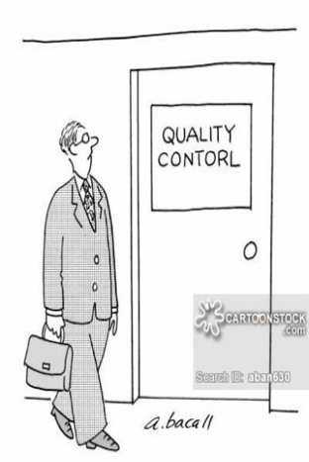
Quality Improvement – The Informatics View
Bob Marshall, MD MPH MISM FAAFP
Program Director, DoD Clinical Informatics Fellowship

Slide 2
Objectives
Provide Basic Review of QI
Contrast QA and QI
Define Quality, Proxy and Process Measures
Review Three Common QI Methodologies
Compare the Three Methodologies
Contrast QI with Research
Briefly Discuss what QI is Not

Slide 3
QI/PI Review
Quality Improvement is a formal approach to the analysis of performance and systematic efforts to improve it
There are numerous models used (later)
Each model is a means to get at the same thing: Improvement
Each represents an ongoing effort to make performance better
In medical practice, the focus is on reducing medical errors and needless morbidity and mortality

Slide 4
Contrasting QA and QI
Quality Assurance – QA was reactive, retrospective, policing, and in many ways punitive
It often involved determining who was at fault after something went wrong
Quality Improvement – QI involves both prospective and retrospective reviews
It is aimed at improvement -- measuring where you are, and figuring out ways to make things better
It specifically attempts to avoid attributing blame
The goal is to create systems that prevent errors from happening

Slide 5
Defining Quality
The definition of quality often depends on the stakeholders
Stakeholders are people with some stake or concern in the process
Stakeholders can be internal or external
In service industries, customer satisfaction is often the primary measure
While healthcare is a service industry, the major focus of QI in healthcare is patient safety
Other important healthcare QI topics include: workflow/throughput (efficiency) and clinical outcomes/proxies

Slide 6
Quality Measures
There are 3 types of measures used in quality work:
Structure: Physical equipment and facilities
Process: How the system works
Outcome: The final product, results
Structure and process are easier to measure; outcome is more important
Structure is a relatively easy concept to define, as it is typically the physical plant (e.g., buildings, equipment, raw material, parts)
Defining process and outcome becomes key in understanding a QI project

Slide 7
Defining Process & Outcome
Process:
How Healthcare is provided
How the system works
Outcome:
Health status
Does it make a difference?

Slide 8
Proxy Measures
Many Healthcare issues are very complex
This leads to the concept of proxy measures. Using a proxy measure means when you can’t measure exactly what you want/need, you measure what you can.
Sometimes you have to use a process measure instead of an outcome
Or you use a measurable process in place of one that is tougher to get at
Proxy measures:
Are used when you can’t exactly measure what you want or need
Measure something that is close enough to reflect similarly

Slide 9
Convenience Samples 1 of 2
One technique for dealing with problematic data sources is to use sampling -- measure a limited number and extrapolate to the whole population
The nice thing about QI is that, unlike research, you don’t necessarily have to do this in a randomized, controlled fashion
You can use a convenience sample -- whatever sample is relatively easy for you to get your hands on
For instance, a convenience sample can be:
A shelf in the file room
A day’s schedule
A single payer group (e.g., Medicaid), especially if data is more readily available

Slide 10
Convenience Samples 2 of 2
When using a convenience sample, you always have to keep in mind that it is NOT a random sample, and may or may not reflect the whole group
On the previous slide, for example, the characteristics of Medicaid patients may be different enough from patients with commercial insurance that your measures may be significantly different for some things

Slide 11
QI Methods - FADE
There are 4 broad steps to the FADE QI model:
FOCUS: Define and verify the process to be improved
ANALYZE: Collect and analyze data to establish baselines, identify root causes and point toward possible solutions
DEVELOP: Based on the data, develop action plans for improvement, including implementation, communication, and measuring/monitoring
EXECUTE: Implement the action plans, on a pilot basis as indicated, and
EVALUATE: Have an ongoing measuring/monitoring (process control) system to ensure success

Slide 12
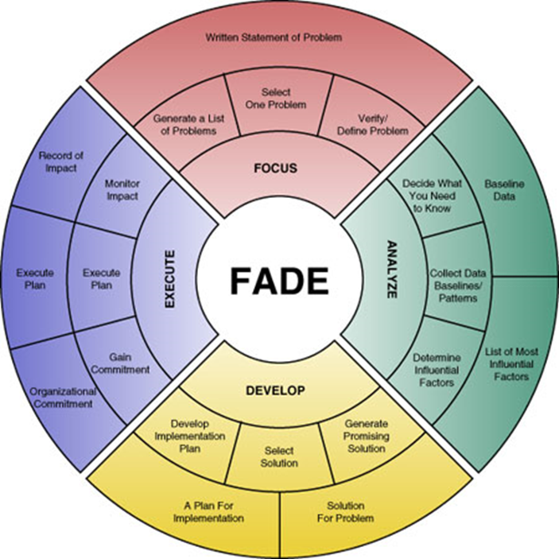

Slide 13
PDSA Model
PLAN: Plan a change or test of how something works.
DO: Carry out the plan.
STUDY: Look at the results. What did you find out?
ACT: Decide what actions should be taken to improve.
Repeat as needed until the desired goal is achieved
Very similar to the FADE model

Slide 14
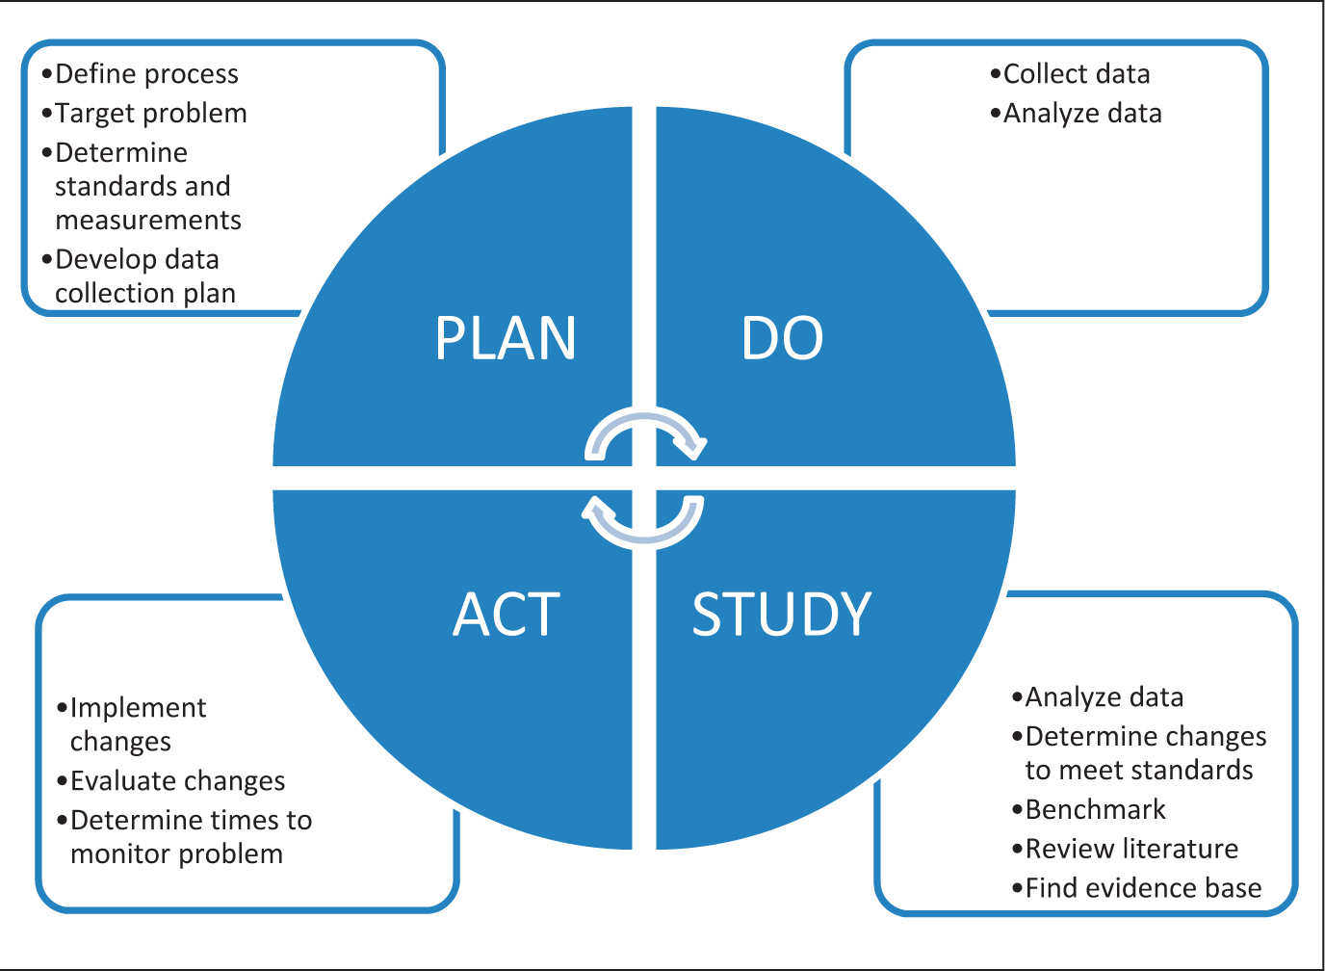

Slide 15
PDSA Example 1 of 2
Issue: Ineffective team meetings were causing more problems than they would resolve
Cycle 1 PLAN – Took suggestions from group; used suggestions to plan implementation of changes & improve meeting effectiveness:
Fewer meetings
Follow an agenda
Assigning tasks prior to meeting

Slide 16
PDSA Example 2 of 2
DO – Documented the process and passed out to group members for commentary and commitment to changes
STUDY – Group members were worried about their assignments and agenda items to submit, today’s topic may not be the “hot” issue when the meeting was held
ACT – Decided to proceed with the changes in spite of the concerns due to perception that the concerns were unfounded and based on fear of change

Slide 17
PDSA Example – Cycle 2
PLAN – New process initiated but only one topic submitted for agenda
DO – He created an agenda with one topic and one regarding the lack of agenda items, assigned roles and held the meeting
STUDY – Meeting was short for the wrong reason. People did not know what format to use when submitting agenda items. Also, concerned about how items would be used
ACT – A form was created for submitting agenda items. Everyone was assigned to submit one item using the form for the next meeting

Slide 18
Six Sigma
The term comes from Sigma’s (Greek Letter) use in statistics to denote Standard Deviation from the mean
Six (6) sigma is equivalent to 3.4 defects or errors per million
Six Sigma is a measurement-based strategy for process improvement and problem reduction completed through the application of improvement projects
This is accomplished through the use of two Six Sigma models: DMAIC and DMADV
DMAIC (define, measure, analyze, improve, control) is an improvement system for existing processes falling below specification and looking for incremental improvement
DMADV (define, measure, analyze, design, verify) is an improvement system used to develop new processor products at Six Sigma quality levels.

Slide 19
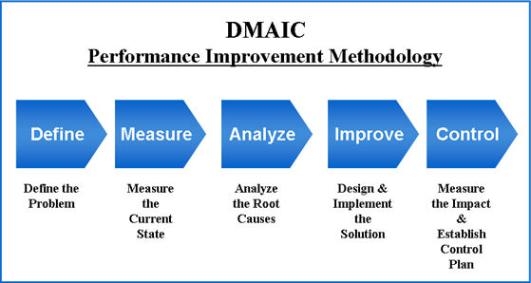

Slide 20
Comparison of the Models

Slide 21
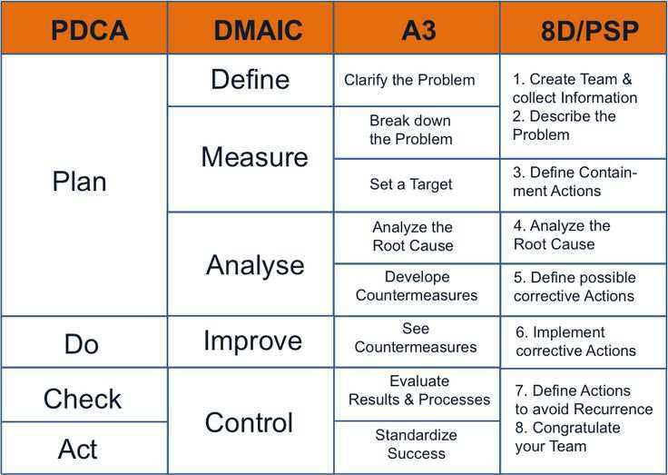
See backup slides for A3 and 8D/PSP.

Slide 22
What QI is NOT
The terms quality improvement and performance improvement are sometimes used interchangeably
Performance Improvement means a change in the system performance
In Healthcare, this is often used to refer to administrative systems, as contrasted to QI as impacting the actual quality of healthcare

Slide 23
QI versus Research 1 of 2
The distinction between QI and research is an important one
There is a spectrum, and it can be blurry sometimes, but there are some key points (with legal implications!)
QI:
Intent is to improve current practice. For internal use only.
By definition, the data is confidential.
Action is within existing standards of care.
Institutional Review Board (IRB) approval is not necessary.

Slide 24
QI versus Research 2 of 2
Research:
Intended to create generalized knowledge
Desire to publish or present
Testing new methods
Needs IRB approval

Slide 25
QI and Clinical Informatics 1 of 2
Good QI is predicated in good data integrity – reliable, accurate, reproducible
Data integrity is reliant on the veracity of the inputs to the EHR
If the inputs are unreliable, so is the data integrity from those inputs
In order for the inputs to be reliable, the easiest thing to do when documenting care should be the most reliable and accurate
That is mostly based on the templates used to document care, proper training of the end users and user-friendly Clinical Documentation Improvement efforts

Slide 26
QI and Clinical Informatics 1 of 2
Within the DoD Healthcare System, how do we:
Maximize the ease of documenting care to ensure high data integrity?
Ensure that even the laziest person documents care well and supports data integrity vice the opposite?
Create the ability to monitor documentation data integrity?
Help the people who either cannot or will not document with a high degree of data integrity (slightly different than the second question)?
Use the data, now of hopefully high integrity, to improve outcomes?
Use the data, now of hopefully high integrity, to improve processes?

Slide 27
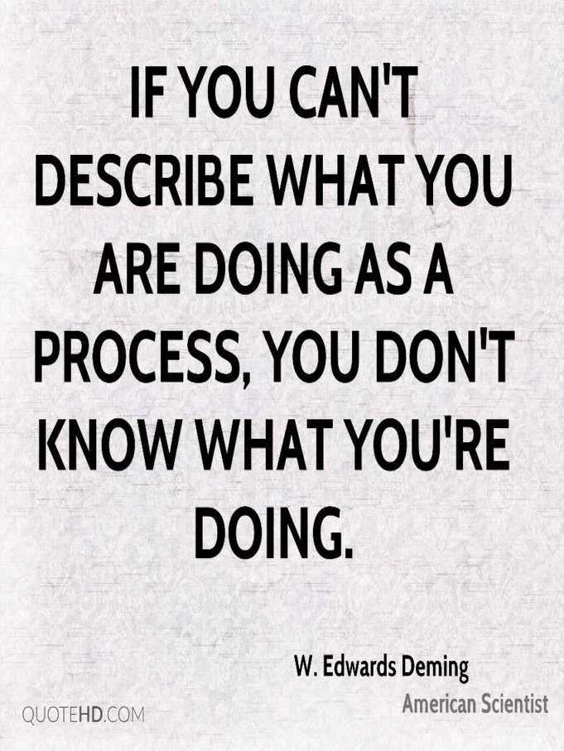
Questions

Slide 28
Backup Slides

Slide 29
A3 QI Methodology
A3 is a structured problem solving and continuous improvement approach, first employed at Toyota and typically used by lean manufacturing practitioners. ... A3 is also known as SPS, which stands for "Systematic Problem Solving"
The process is based on the principles of Deming's PDCA (Plan-Do-Check-Act

Slide 30
8D/PSP QI Methodology
The eight disciplines (8D) model is a problem solving approach typically employed by quality engineers or other professionals and commonly used by the automotive industry
Its purpose is to identify, correct, and eliminate recurring problems, and it is useful in product and process improvement
The approach establishes a permanent corrective action based on statistical analysis of the problem and focuses on the origin of the problem by determining its root causes
Although it originally comprised eight stages, or disciplines, it was later augmented by an initial planning stage

